Slide 1
Training Images

Slide 2
Image
An image is a picture that has been created by combination of vectors or values.
An image can be described in terms of vector graphics or raster graphics.
An image stored in raster form is sometimes called a bitmap.

Slide 3
Color Space
Color image is combination of three channel
Red Channel
Green Channel
Blue Channel

Slide 4
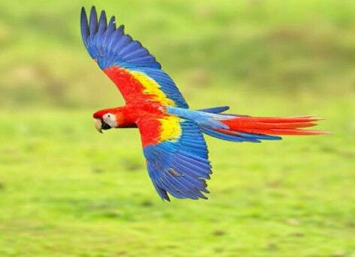
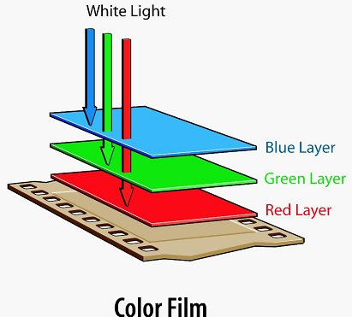
Basics of Image Processing
(343, 473 , 3)

Slide 5
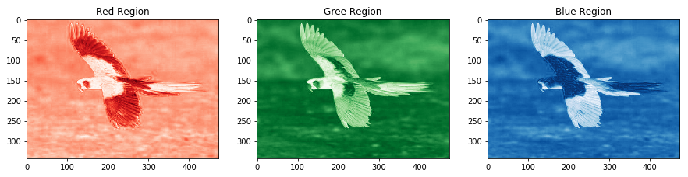
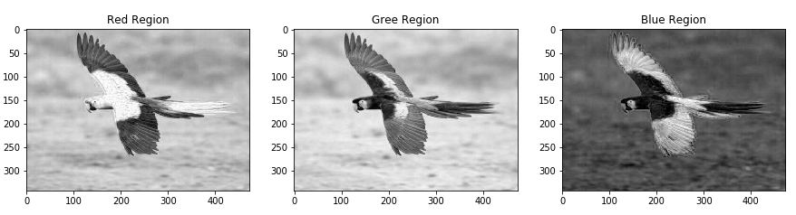
(343, 473)
(343, 473)
(343, 473)
(343, 473 , 3)
(343, 473)
(343, 473)
(343, 473)

Slide 6
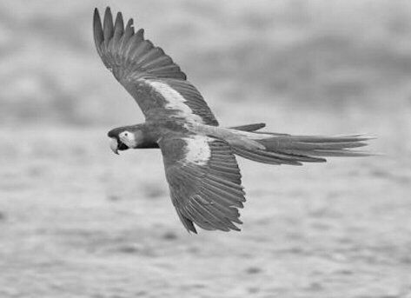
Use of Grayscale image
(343, 473 , 3)
(343, 473)
Length of matrix or array reduce by 3 times hence the computation time

Slide 7



Deeper into Image
PIXELS
(1200 , 1200 , 3)

Slide 8
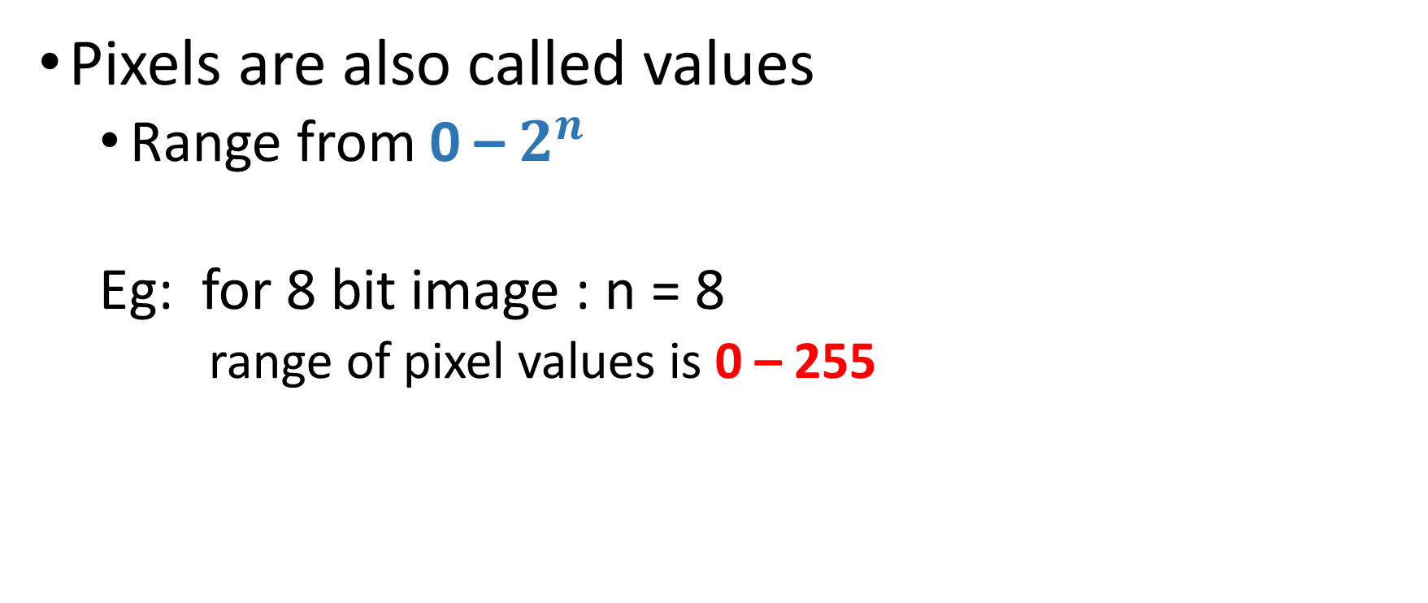
PIXELS
Pixels are also called values
Range from 0 – $2^{n}$
Eg: for 8 bit image : n = 8
range of pixel values is 0 – 255

Slide 9
PIXELS
Lower the value darker the color
Eg: black color for gray scale image
Higher the value lighter the color
Eg: White color for gray scale image
0
255

Slide 10
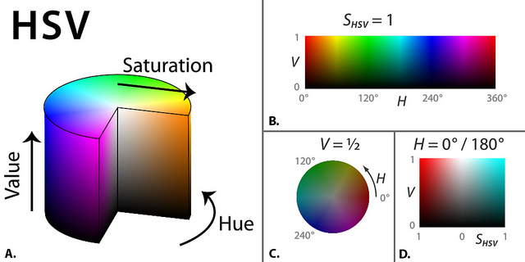
Color Space

Slide 11

Array in graphical representation
Image is matrix and representation in graphical manner
0
230
255
53
235
255
20
240
255
0
255
70
255
100
120

Slide 12
Information in Image
Skill of extraction information or knowledge from data is called Data Science
Transformation
Analysis
Modeling
(1200, 1200)

Slide 13
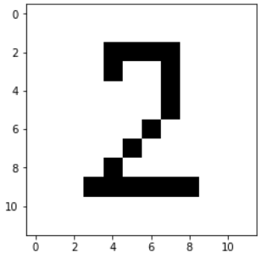
Data Transformation
Transforming the data into structured
Resize {Bring the all image into same shape}
Reshaping
Converting into either row matrix or column matrix
(10, 10)
(1, 100)

Slide 14
Analysis
Number of black bars
Distance between each bars
Width of each bars
Position or index of bars
(1, 100)

Slide 15
Train images or arrays

